Slide 1



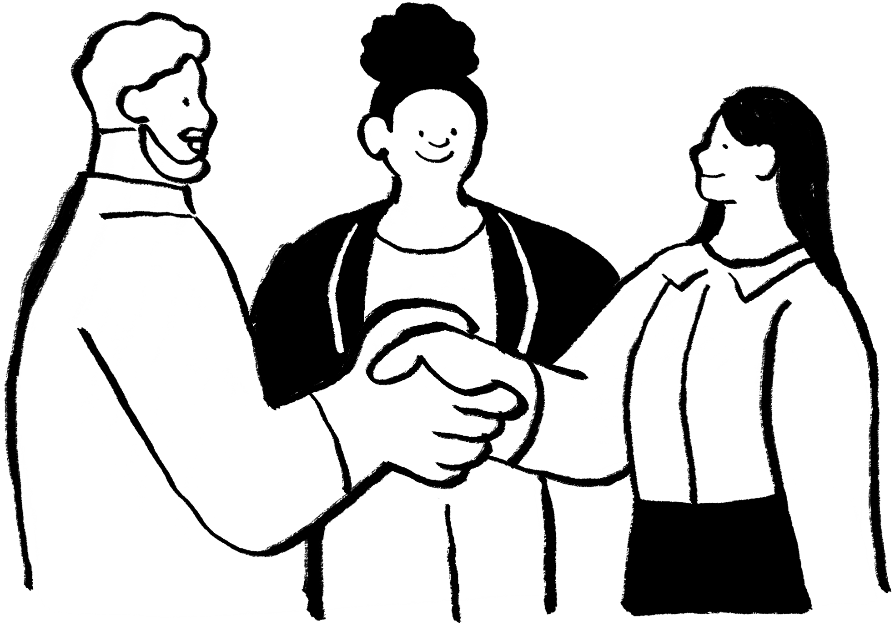




GLOBAL ACADEMY OF TECHNOLOGY
An Autonomous Institute, Affiliated to VTU Belagavi, Approved by AICTE, Accredited by NAAC with "A" Grade, Ideal Homes Township, Rajarajeshwari Nagar, Bengaluru-560098
# BEYOND INNOVATION
Project Title: Traffic congestion prediction
Team Name: Heralds
Team Number: HAL 45
Team Members: Altaf Ali, Rohan Sarkar, Mohamad Harshad, Shakthi Ganesh
College Name: T John Institute of Technology

Slide 2
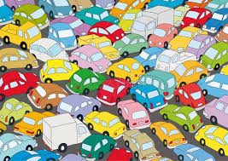

PROBLEM STATEMENT
Urban cities continue to develop at a rapid rate, due to which traffic congestion has increased tremendously.
This leads to longer commute times and decreases our quality of life.
The static nature of traffic lights fail to account for dynamic changes.
Our goal is to build a system that can help traffic system dynamically adapt to the changes in traffic to ensure good commute.

Slide 3


SCOPE
When implementing digital twin in a real city, we will have to collect live data so that we can make necessary changes to traffic.
We can gather data through various means, like making use of IoT devices, cameras and drones, and GPS data from cars.
In this project, we intend to simulate traffic data of 4-5 intersections in a small city.
Traffic congestion is often a major issue in many metropolitan cities.
Many cities are already figuring out solutions to reduce the traffic, hence it is relevant to our current day-to-day life.

Slide 4
SOLUTION REVIEW
We intend to simulate traffic data at intersections with traffic congestion levels, vehicle count and other data.
Based on this data, we can try to predict the dynamic changes on roads.
We’ll make use of some simple algorithm to predict congestions or any other changes in traffic.
The algorithm can be made into a machine learning algorithm so that it can learn over time.

Slide 5
TECHNICAL APPROACH
Python
SimPy
Matplotlib
Numpy
Gradio or Flask

Slide 6
IMPACT AND BENEFITS
If this solution can be implemented successfully then it could have a positive impact on daily commuters.
By predicting traffic flow according to the changes it could make it easier for the city to optimize the traffic flow.
This means we could reduce idling time at intersections and potentially reduce carbon emission from vehicles.

Slide 7
CONCLUSION
This project has the potential to improve the daily commute in metro cities.
It is also possible to implement this city-wide as we can integrate the software with existing hardware components.
We can enhance this further by automating traffic lights at intersections so that the flow of traffic is smoother.

Slide 8
Thank You

